Slide 1
IBM Cloud Code Engine

Slide 2
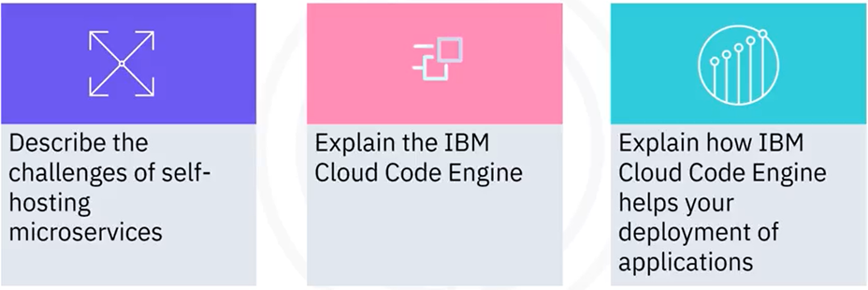
What you will learn

Slide 3
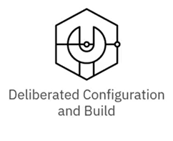
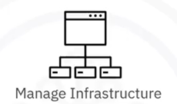



Challenges of self-hosting microservices

Slide 4
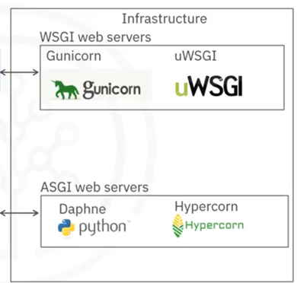
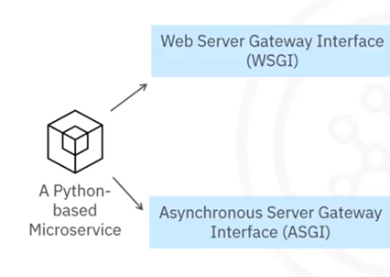
Example: Deploy a Python-based microservice

Slide 5
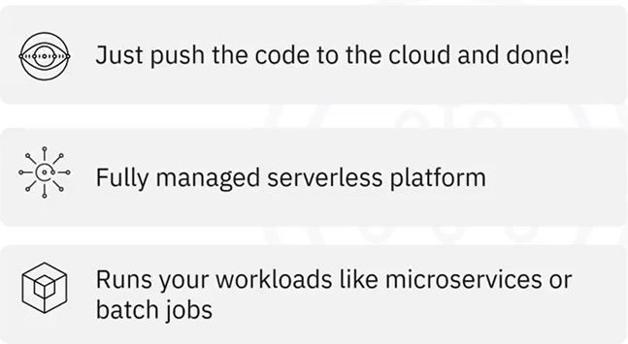
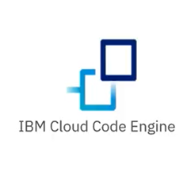
IBM Cloud Code Engine

Slide 6
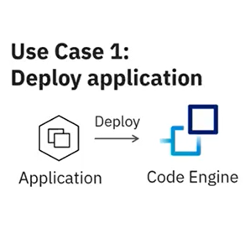

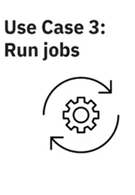
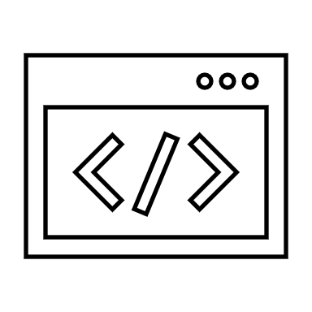
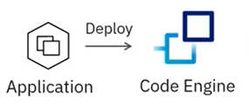
Main use cases

Slide 7

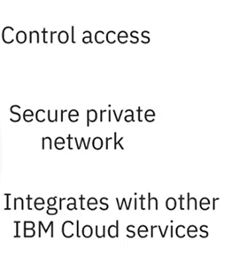
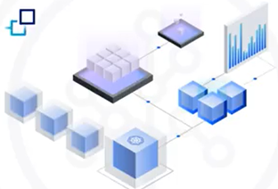
Main benefits

Slide 8
Recap
In this video, you learned that:
• Self-hosted microservices can be complex and challenging
• IBM Cloud Code Engine is a fully managed platform that takes
care of the hard deployment work, allowing developers to focus
on code
• IBM Cloud Code Engine has three main use cases: deploy
applications, build and deploy applications, and run jobs

